Slide 1
Workshop on Data Science
Introduction to Data Science

Slide 2
Today’s Agenda
Basic Statistics
Basic Python
Implementations of Statistics
Exploratory Data Analysis
Bonus: Remember python functions through Gen AI

Slide 3
Basic Statistics
Mean: This is the most familiar one, also known as the average. It's calculated by adding all the values in your data set and dividing by the total number of values.
Mean: (2 + 5 + 5 + 7 + 8 + 10) / 6 = 5.8 (average score)
Median: Imagine arranging your data points in ascending or descending order. The median is the "middle" value. If you have an odd number of data points, it's the exact middle one. With an even number of values, the median is the average of the two middle numbers.
Median: Arranging scores gives: 2, 5, 5, 7, 8, 10. Since we have an even number, the median is the average of the 3rd and 4th value (5 + 7) / 2 = 6 (middle score)
Mode: This refers to the most frequent value in your data set. There can be one mode, multiple modes (bi-modal or tri-modal for two or three most frequent values), or even no mode if no value repeats itself.
Mode: The score 5 appears twice, making it the mode (most frequent score)

Slide 4
Basic Statistics contd.
Population: The entire group you want to study (all adults in a country, all voters). Huge!
Sample: A smaller group representing the population (a survey sent to some adults, a selection of voters). More manageable for research.
We use the sample to learn about the whole population. Imagine a giant fish (population) - you can't examine it all, so you take a smaller fish (sample) to understand the big one.

Slide 5
Basic Statistics contd.
Standard Deviation (SD):
What it measures: Spread or dispersion of data from its mean (average).
Values: Always non-negative (0 or positive). A higher standard deviation indicates data points are further from the mean, while a lower SD suggests they are clustered closer to the mean.
Interpretation: Helps understand how much variation exists within your data set.
Correlation:
What it measures: Strength and direction of a linear relationship between two variables.
Values: Ranges from -1 to +1.
-1 indicates a perfect negative correlation (as one variable increases, the other decreases proportionally).
0 indicates no linear correlation (no relationship between the variables).
+1 indicates a perfect positive correlation (as one variable increases, the other increases proportionally).
Interpretation: Tells you if two variables tend to move together (positive or negative) or if there's no connection between them.

Slide 6
Why python programming?
Easy to learn – Beginner's programming language
Cross-platform Interpreted Language
Clean and Elegant Syntax
Free and Open source
Large Standard Library
High Level Language
General purpose Language
Object-Oriented Programming Language
Integrated – Easily integrated with C, C++, JAVA, etc..

Slide 7
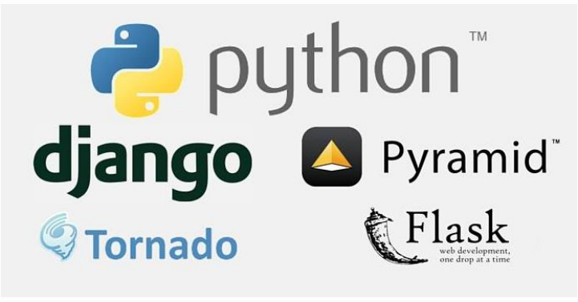
Application Areas
Web Development – Django, Flask, Web2py, Bottle, Tornado

Slide 8



Application Areas
Graphical User Interfaces – Kivy, PyQT, Tkinter, PyGUI, PySide, WxPython, pygame

Slide 9




Applications areas
Multimedia Programming - PyMedia, GStreamer, PyGame, Pyglet

Slide 10


Applications areas
Database Programming – Supporting connectors for all databases
Networking – Asyncio, Diesel, Pulsar, Twisted, NAPALM
Automation – ANN, IOT, MicroPython, Embedded Systems

Slide 11



Application Areas
Web Scraping – Beautiful Soup, Scrapy, Requests, Selenium
System Administration – Fabric, Salt, Psutil, Ansible, Chef, Puppet, Blueprint, Buildout, Shinken
Scientific Computing – Astrophy, Biopython, Bokeh, Cubes, Dask, Matplotlib, NetworkX, NumPy, Pandas, PyTorch, SciPy

Slide 12





Application Areas
Text Processing – NLTK, Polyglot, TextBlob, CoreNLP, Pattern, Vocabulary, QuePy
Image Processing – OpenCV, Pillow, Scikit-image
Machine Learning – Scikit-learn, TensorFlow, Keras, Theano, PyTorch
Data Analytics – NumPy, Pandas, Matplotlib, Seaborn, Plot.ly, SciPy
Data Science – ML, DA, TensorFlow, Keras

Slide 13
Lets do some coding
4+5
8/3
4//2
19* “o”
a = 34
b = “good”
print(b)
print(a,b)

Slide 14
Getting output in console
The print() function
Syntax
print(*objects, sep=‘ ‘, end=‘\n’, file=sys.stdout, flush=False)
*objects – Objects to print (can be single or multiple).
sep – The separator string to separate two values in case of printing multiple objects.
end – String to be printed after all objects are printed.
file – The location where we want to print our output.
flush – Normally output to a file or the console is buffered, with text output at least until you print a newline. The flush makes sure that any output that is buffered goes to the destination.

Slide 15
Python comments
Comments can be used to explain Python code.
Comments can be used to make the code more readable.
Comments can be used to prevent execution when testing code.
Comments starts with a #, and Python will ignore them
#This is a comment
print("Hello, World!")
print("Hello, World!") #This is a comment
We can use multi line comments also using triple quoted string (although it means something else, we will discuss it later on)
“””This is a comment
Multiline comment”””

Slide 16
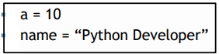
Python variables
Variable is a name used to refer memory locations because we can’t remember memory addresses and used to hold values.
In Python, we don’t need to specify type of the variable because Python is smart enough to get variable type.
Variables can be named using combination of letters, digits and underscore (_) . No other special symbol can be used.
Variables can begin with letter or underscore but not with digit.
Python is case sensitive language.
Variables can also be called as identifiers.
Valid identifiers:- a123, _n, n_9
Invalid identifiers:- 1a, n%4, n 9
The equal (=) operator is used to assign value to a variable.
Python doesn’t bound us to declare variables before use. It allows us to create variable at required time.
Example:

Slide 17
Python variables contd.
Python support Multiple Assignments
x=y=z=50 #(Here, x,y,z have same value i.e., 50)
x,y=20,42 #(Here, x =20 and y=42)
Examples to demonstrate the variables: -
a=10
b,c=20,30
x=y=z=50
print(a)
print(b)
print(c)
print(x)
print(y)
print(z)

Slide 18
Python keywords
>>> import keyword
>>> keyword.kwlist
['False', 'None', 'True', 'and', 'as', 'assert', 'break', 'class', 'continue', 'def', 'del', 'elif', 'else', 'except', 'finally', 'for', 'from', 'global', 'if', 'import', 'in', 'is', 'lambda', 'nonlocal', 'not', 'or', 'pass', 'raise', 'return', 'try', 'while', 'with', 'yield']

Slide 19
Python operators
Arithmetic +,-,*,/,//,**,%
Relational >, <, >=, <= , ==, !=
Assignment =, +=, -=, *=, /=, //=, **=, %=
Logical and, or, not
Bitwise &, |, ^, <>
Identity is, is not
Membership in, not in

Slide 20
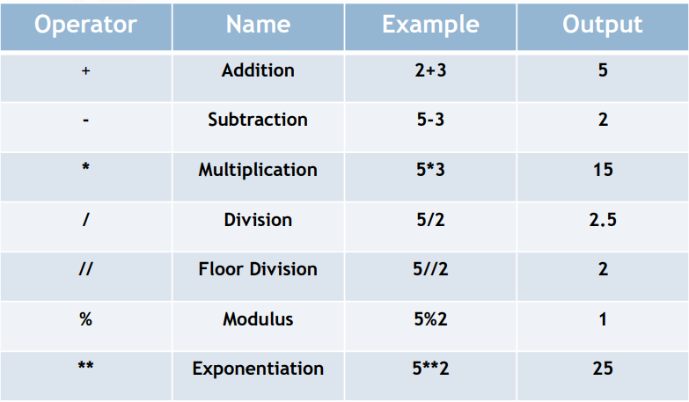
Arithmatic operators

Slide 21
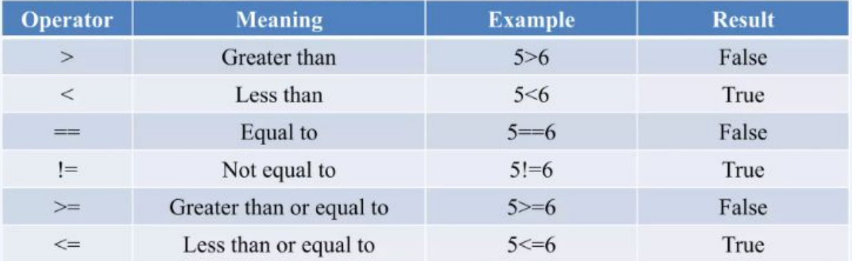
Relational operators

Slide 22
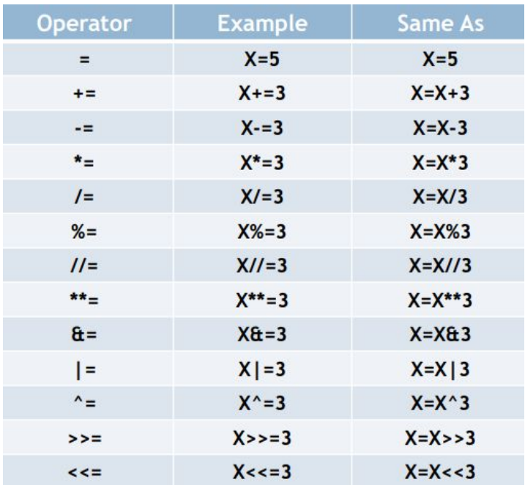
Assignment operators

Slide 23
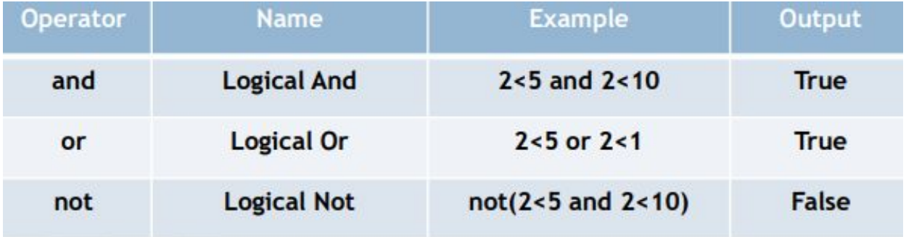
Logical operators

Slide 24
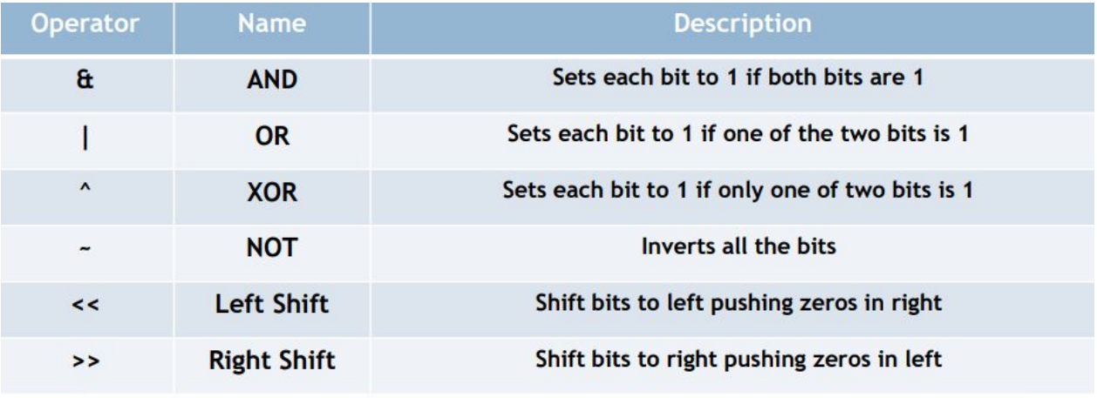
Bitwise operators

Slide 25
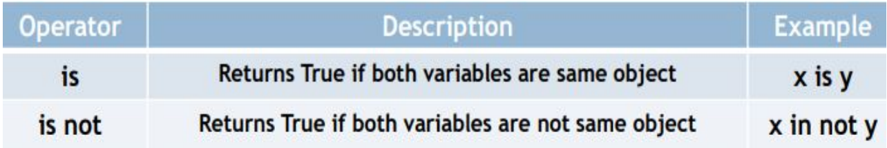
Identity operators

Slide 26
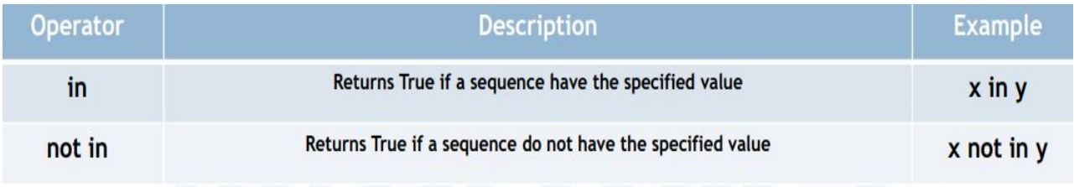
Membership operators

Slide 27
Use of brackets
() Function Arguments, Expressions, Tuples
{} Dictionary, Sets
[] Lists, Indexing Slicing
<> not used as brackets

Slide 28
Data Types
Python Built-in Data Types

Slide 29
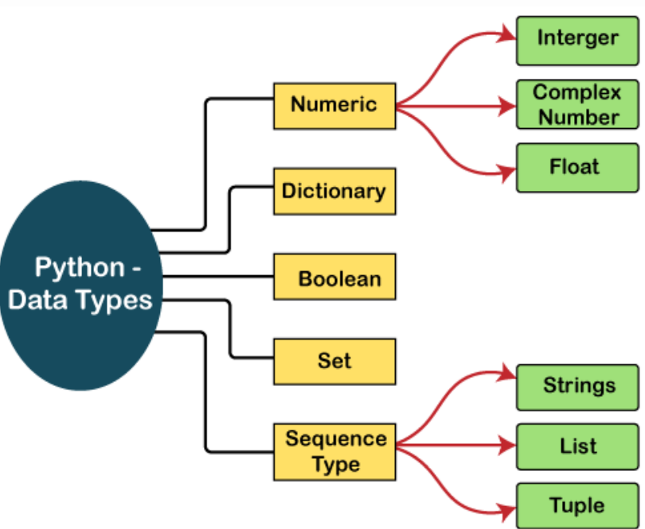

Slide 30
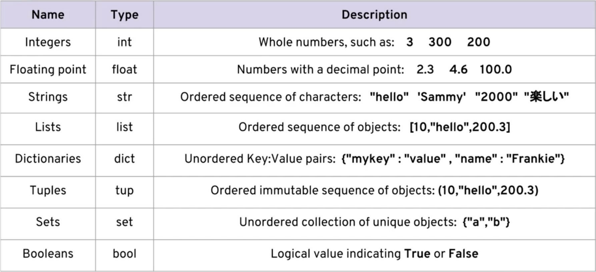

Slide 31
Numeric categories
Data Classes Built-in Functions

Slide 32
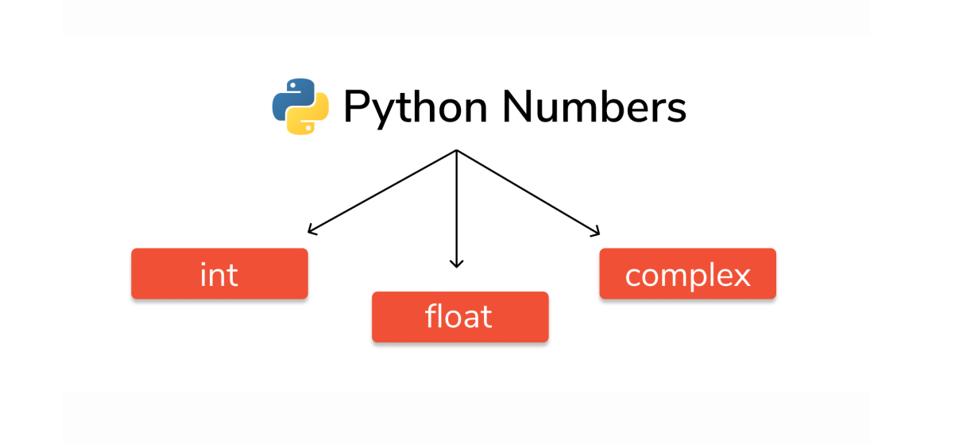

Slide 33
Lets do coding

Slide 34
strings
Data Classes Built-in Functions

Slide 35
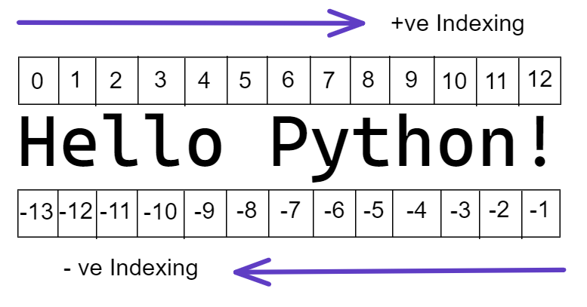
Accessing string using indexing
Index of strings starts with 0 and ends with (n-1). Here, n stands for the total number of characters in the string i.e., length of string.

Slide 36
Built-in functions available on strings
capitalize()
title()
upper()
lower()
center()
split()
count()
len()
replace()

Slide 37
Lets do coding

Slide 38
list
Data Classes Built-in Functions

Slide 39
list
List Concatenation
List Reptation

Slide 40
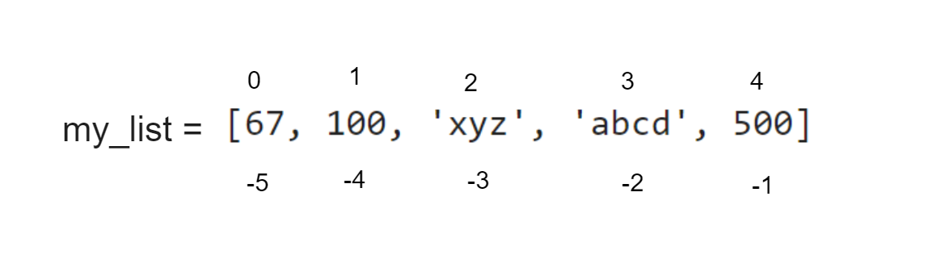
Accessing list using indexing and slicing
Index of lists starts with 0 and ends with (n-1). Here, n stands for the total number of elements in the list i.e., length of list.

Slide 41
List functions
len()
append()
extend()
remove()
count()
reverse()

Slide 42
Lets do coding

Slide 43
dictionary
Data Classes Built-in Functions

Slide 44
Accessing dictionary
To access dictionary value use key enclosed by square braces.
Example
d = { “name”:”Akash”, “age”:22}
print(d[“name”])

Slide 45
Dictionary functions
len()
pop()
keys()
values()
items()
copy()
clear()

Slide 46
Lets do coding

Slide 47
Control flow statements
Python Programming

Slide 48
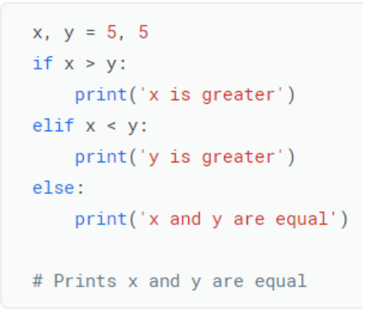
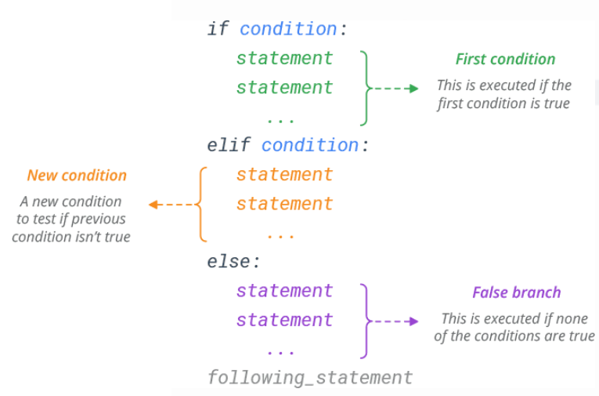
If-elif-else

Slide 49
Lets do coding

Slide 50
while
Loop Statements

Slide 51
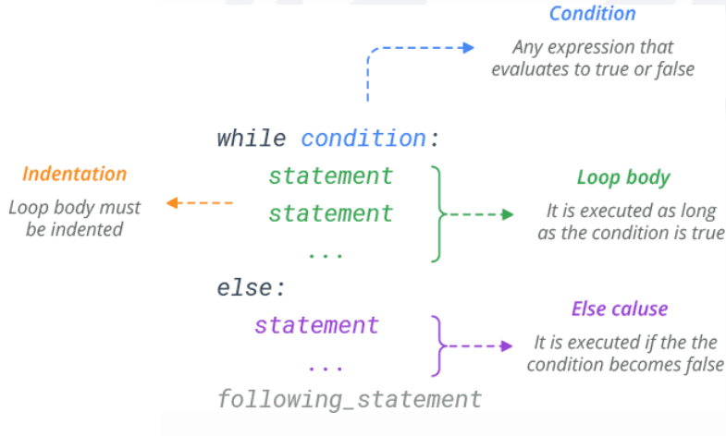
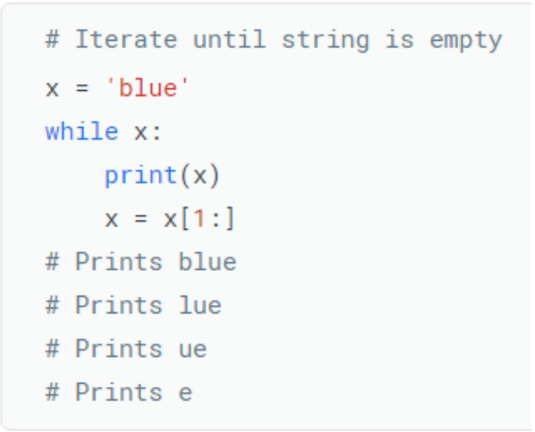
while
A while loop is used when you want to perform a task indefinitely, until a particular condition is met. It’s a condition-controlled loop.

Slide 52
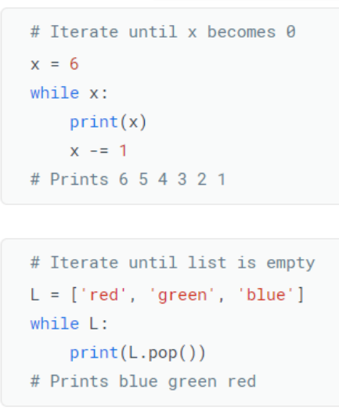
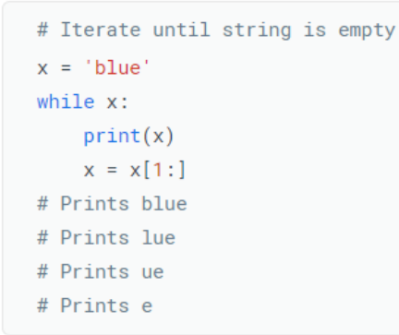
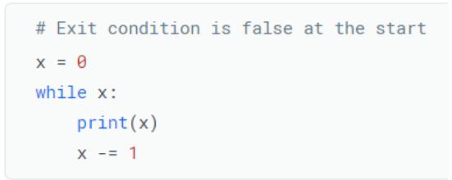
While loop examples

Slide 53
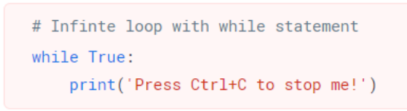
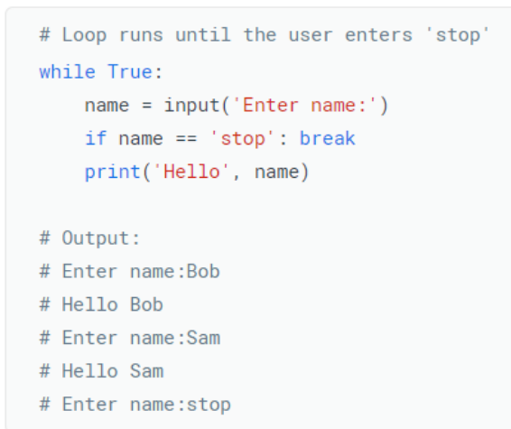
Infinite loop

Slide 54
for
Loop Statements

Slide 55
For loop
The for statement in Python is a bit different from what you usually use in other programming languages.
Rather than iterating over a numeric progression, Python’s for statement iterates over the items of any iterable (list, tuple, dictionary, set, or string).
The items are iterated in the order that they appear in the iterable.

Slide 56
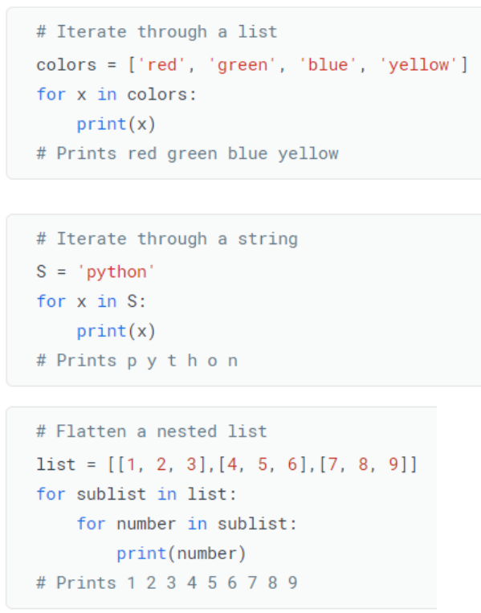
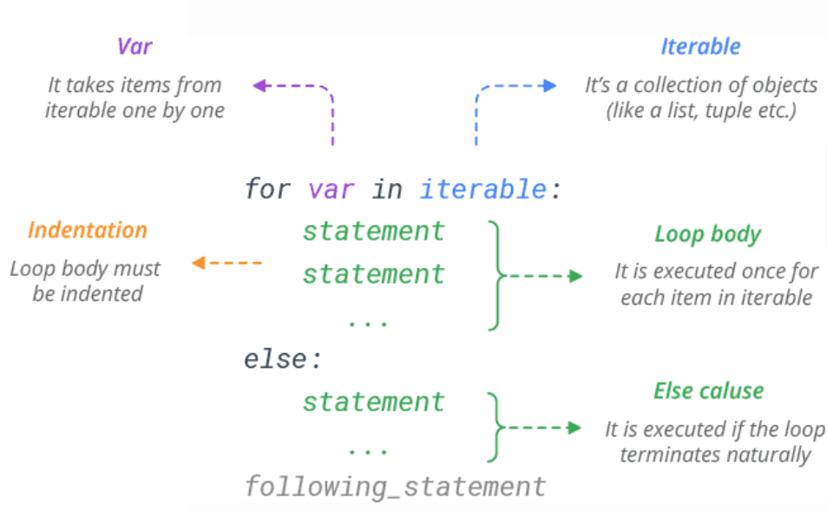
For loop contd.

Slide 57
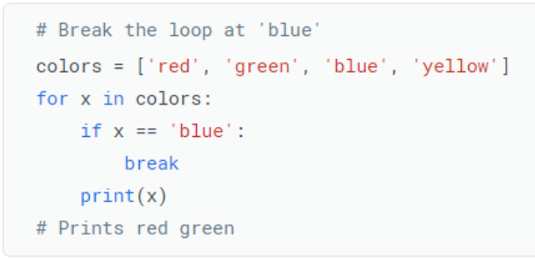
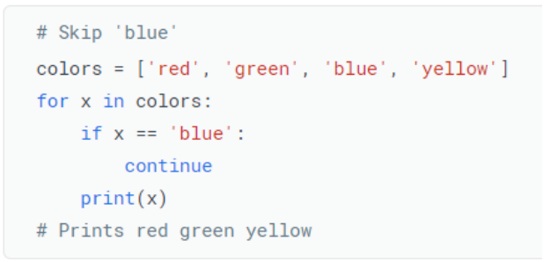
Break & continue in for loop

Slide 58
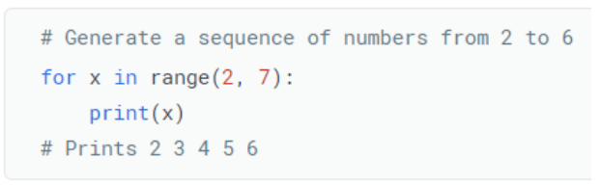
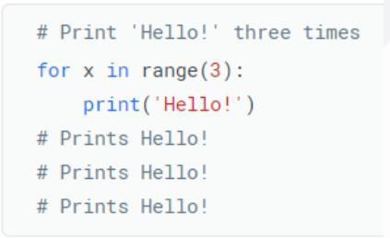
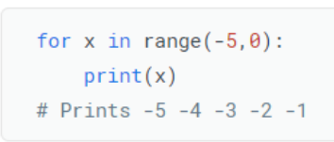
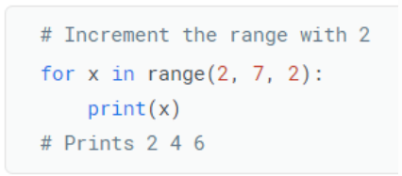
Using range functions
The range(start,stop,step) function generates a sequence of numbers from 0 up to (but not including) specified number.

Slide 59
Lets do coding

Slide 60
User defined functions
Python Functions

Slide 61
Python user defined functions
A block of code which only runs when it is called.
Enables code reusability.
We can pass data, known as parameters.
A function can return data as a result.
We use def keyword to create a function.
A block is created, So pay attention to Indentations.
Build to perform a specific task.
Types of Functions
Parameterized and Non Parameterized functions
Anonymous Functions/Lambda Expressions
Generator Functions
Decorator Functions

Slide 62
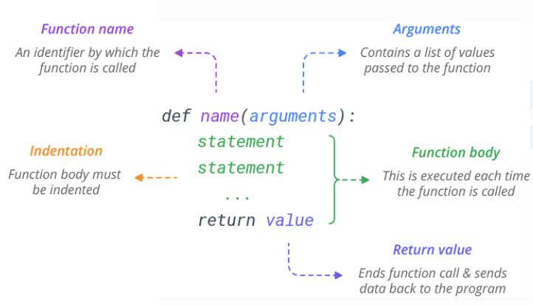
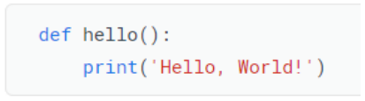
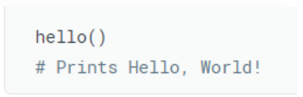
udf
Creating
Calling

Slide 63
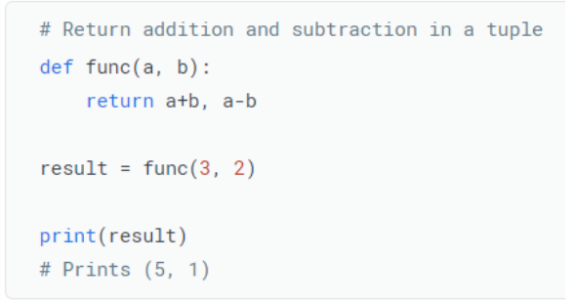
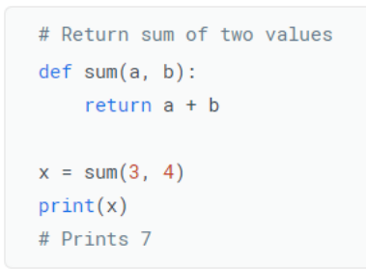
Return value from functions
To return a value from a function, simply use a return statement.
Once a return statement is executed, nothing else in the function body is executed.
Python has the ability to return multiple values, something missing from many other languages.
You can do this by separating return values with a comma

Slide 64
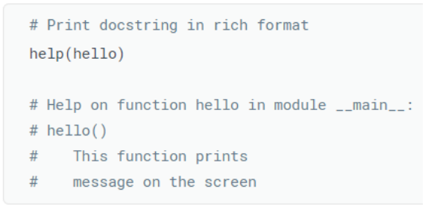
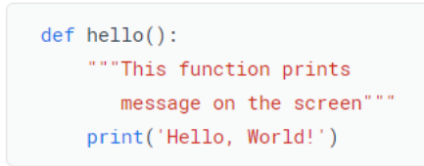
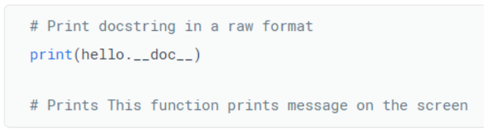
The docstring
You can attach documentation to a function definition by including a string literal just after the function header.
Docstrings are usually triple quoted to allow for multi-line descriptions.

Slide 65
Lets do coding

Slide 66
Module and packages
Python Modules

Slide 67
Installing python modules
python –m pip install
Or
pip install <module>
For multiple python versions, specify python version
To install PIP (Python Package Installer)
Download get-pip.py
Run
python get-pip.py

Slide 68
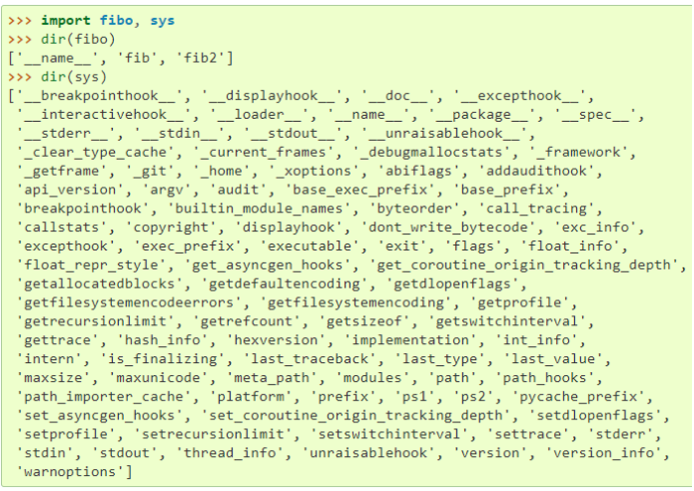
Common modules
os
sys
math
json
csv
numpy
pandas
sklearn
tkinter
Using dir() function

Slide 69
Exploratory Data Analysis

Slide 70
Exploratory Data Analysis contd.
Exploratory Data Analysis (EDA) is a crucial initial step in data analysis, especially within the field of data science. It's a process of investigating, uncovering, and summarizing the key characteristics of your data set.
Goals of EDA:
Understanding the data: Gain insights into the structure, content, and potential issues within your data.
Identifying patterns and trends: Discover relationships between variables, potential outliers, and interesting patterns that might guide further analysis.
Data cleaning preparation: Identify and address missing values, inconsistencies, or errors for a more robust analysis.
Formulating hypotheses: Based on your exploration, you can develop initial questions or hypotheses to be further tested through statistical modeling.

Slide 71
Exploratory Data Analysis contd.
Techniques used in EDA:
Data visualization: Creating charts and graphs to explore data distribution, central tendency, and relationships between variables. Common plots include histograms, scatter plots, boxplots, etc.
Summary statistics: Calculating measures like mean, median, mode, standard deviation, and quartiles to understand the data's central tendency and spread.
Data cleaning: Identifying and addressing missing values, outliers, inconsistencies, or errors to ensure data quality.

Slide 72
Exploratory Data Analysis contd.
Benefits of EDA:
Informed data analysis: Provides a solid foundation for further statistical modeling or machine learning by understanding your data's characteristics.
Uncovering hidden insights: May reveal unexpected patterns or relationships that could be crucial for your analysis.
Improved data quality: Helps identify and address data quality issues before diving into complex models.
Overall, EDA is an iterative process

Slide 73

pandas

Slide 74
What is pandas ?
Pandas is a Python library used for working with datasets.
It has functions for analyzing, cleaning, exploring, and manipulating data.
Pandas allows importing data from various file formats such as comma-separated values, tab-separated values, JSON, SQL database tables or queries, and Microsoft Excel.
Even we can do some basic visualization with it.

Slide 75
Types of data structure in pandas
Data Structure | Dimension | Description
Series | Single column | It is a 1D array holding data of any type. Example.
DataFrame | Multiple column | It is a 2D data structure, like a 2D array, or a table with rows and columns.
Panel | Multiple Table | It is a 3D container of data.

Slide 76
Pandas Series
Pandas Series is a one-dimensional labeled array capable of holding any data type, like int, float, string etc.
Series represents a single column with index, which is either independent or belongs to a Pandas DataFrame.
We can create a series from list, tuple, dictionary and numpy array.
To create a series first we have to import the pandas library.
>>> import pandas as pd
>>> pd.Series([1,2,3,4,5]) #from list
>>> pd.Series(('a','b',20,7.5)) #from tuple
>>> pd.Series({'a':12,'b':23,'c':'AB','d':'OX'}) #from dictionary
>>> pd.Series(np.array([11,20,12,32,52])) #from numpy array

Slide 77
Pandas DataFrame
Pandas DataFrame is a widely used data structure which works with a two-dimensional array with labeled axes (rows and columns).
We can create DataFrame using list, tuple, dictionary, numpy array and pandas series.
To create a data frame first
import pandas as pd
>>> pd.DataFrame([[1,2,3],[11,22,33],[111,222,333]]) #using list
>>> pd.DataFrame(((10,20,30),(21,22,23),(74,52,25))) #using tuple
>>> pd.DataFrame({'a':[5,2],'b':[4,3],'c':[9,5]}) #using dictionary
>>> pd.DataFrame([np.array([5,2,3]),np.array([1,6,4]),np.array([0,7,2])])
>>> pd.DataFrame([pd.Series([4,7,1]),pd.Series([3,5,1]),pd.Series([8,7,1])])

Slide 78
Basic Functionality and attributes of DataFrame
>>> df=pd.DataFrame({'a':[5,2,9],'b':[4,3,8],'c'[9,5,7],'d'['x','y','z']})
df.head()
Returns first five records.
df.tail()
Returns last five records.
df.sample()
Returns only one random sample.
df.info()
Returns the basic information of the dataset.
df.describe()
Returns the description of the data.

Slide 79
Basic Functionality and attributes of DataFrame contd.
df.shape
Returns the DataFrame shape
df.dtyes
Returns the columns data type.
df.index
Returns a RangeIndex object with the start, stop, and step values.
df.values
Returns all the values in the DataFrame.
df.columns
Returns all the columns name.

Slide 80
Checking & Handling Duplicates
>>> data = {'score':[98,98,48,75,75,96,96], 'stream':['EE','EE','IT','CS','CS','MCA','MCA'] }
>>> df2 = pd.DataFrame(data)
df2.duplicated()
Duplicated values are indicated as True values in the resulting Series.
df2.duplicated().sum()
Returns the sum of total duplicates
df2.drop_duplicates(subset=['col'],inplace=True)
Return DataFrame with duplicate rows removed.

Slide 81
Checking & Handling Null Values
>>> data2 = {'score':[98,np.nan,48,75,np.nan,96,np.nan], 'stream':['EE',np.nan,'IT',np.nan,'CS','MCA',np.nan], 'pincode':[np.nan,np.nan,np.nan,np.nan,np.nan,np.nan,np.nan] }
>>> df3 = pd.DataFrame(data2)
df3.isna()
Detect missing values. Show which entries in a DataFrame are NA.
df3.isnull()
Detect missing values. Show which entries in a DataFrame are NA.
df3.isnull().sum()
Returns the total number of null values in each columns.
df3.fillna(value=None, *, method=None, axis=None, inplace=False)
Fill NA/NaN values using the specified method.

Slide 82
Dropping columns and rows
df3.drop(columns = list_of_cols_to_drop,inplace=True,axis=1)
For permanent drop of columns
df3.drop(rows = list_of_rows_to_drop,inplace=True,axis=0)
For permanent drop of rows.
df3.dropna(axis= 1 or 0, inplace=True])
Return a new Series with missing values removed.

Slide 83
Selecting columns from a DataFrame
Create a DataFrame
>>> data = {'name':['avi','akshat','ankita','riya','sourav'], 'roll_no':[25,45,20,5,42],'score': [98,48,75,80,96], 'stream':['EE','IT','CS','ECE','MCA'] }
>>> df4 = pd.DataFrame(data)
Example:
First selecting a single column
>>> df4['score']
Selecting multiple column
>>> df4[['name', 'score']]
>>> df4[['stream','roll_no','score']]

Slide 84
Matplotlib & Seaborn
Data Visualization Libraries

Slide 85
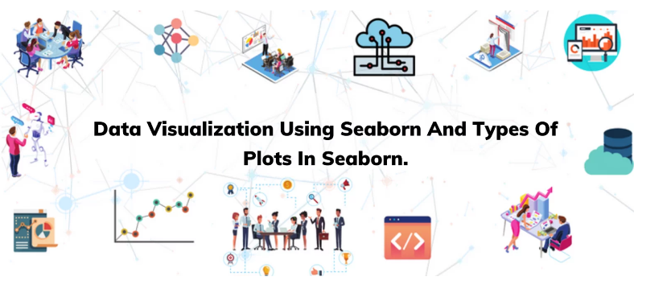
Matplotlib and seaborn
Matplotlib is a Python library for creating static, animated, and interactive visualizations.
Seaborn is a Python data visualization library based on Matplotlib, another popular plotting library. Seaborn is specifically designed for creating attractive and informative statistical graphics.

Slide 86
Some common graph
Line plot
Bar graph
Histogram
Boxplot
Scatter plot (need two numerical columns for two axis)
Stem plot
violin plot
Kernel density Estimator(KDE)

Slide 87
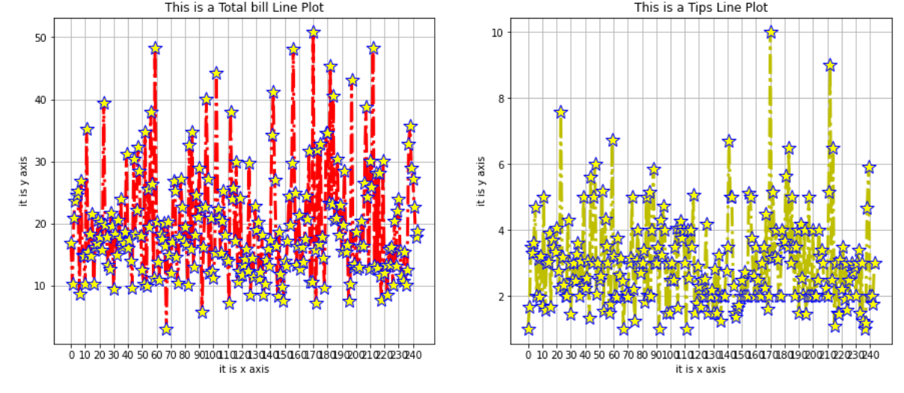
Line plot

Slide 88
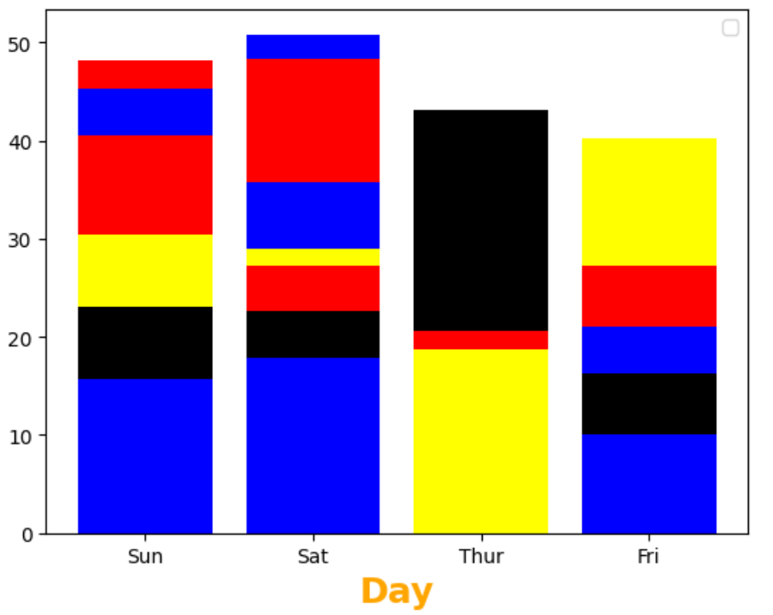
Bar plot

Slide 89
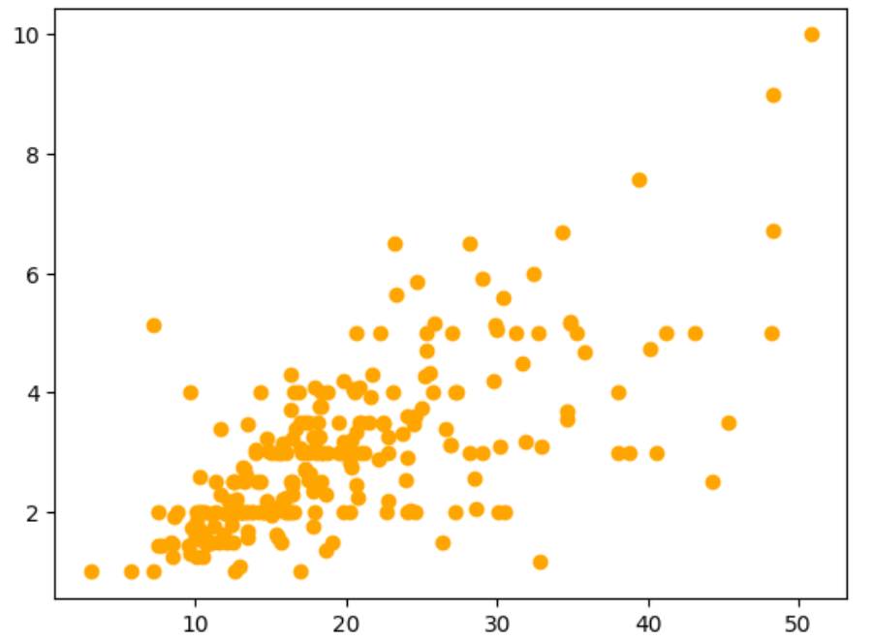
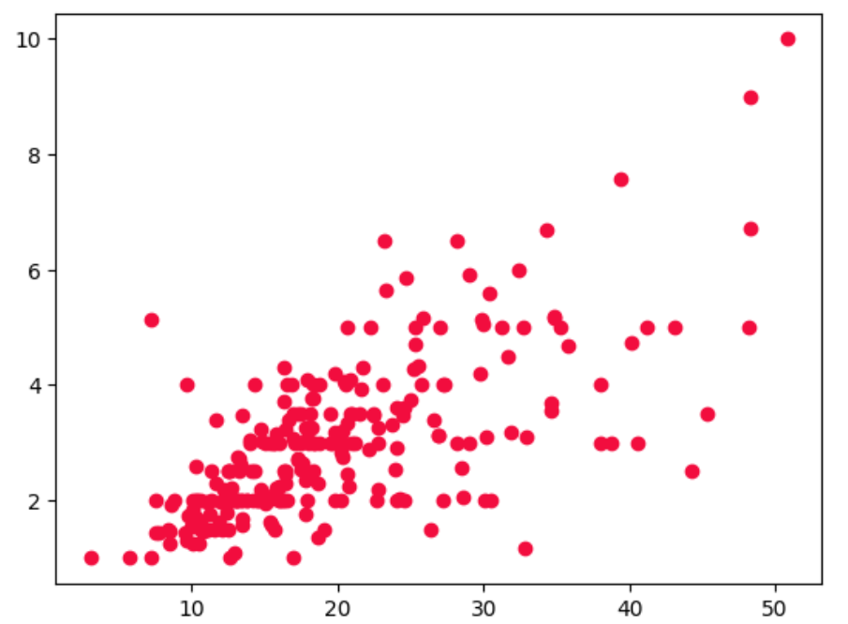
scatter plot

Slide 90
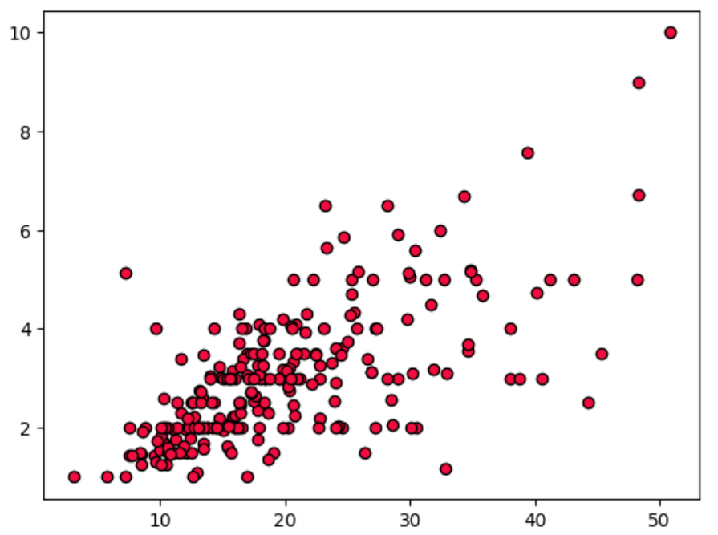
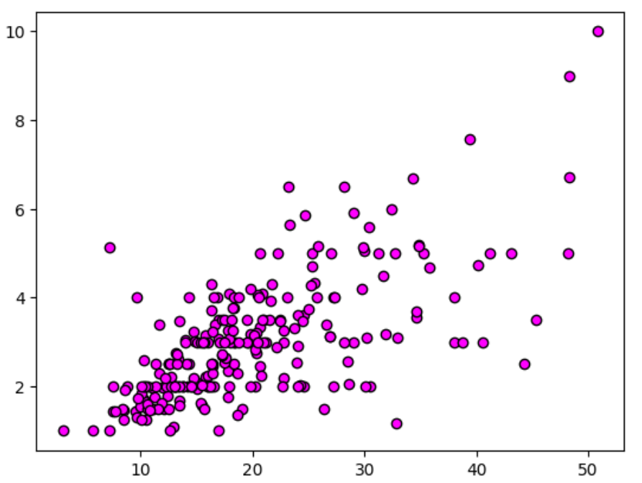
Customize scatter plot

Slide 91
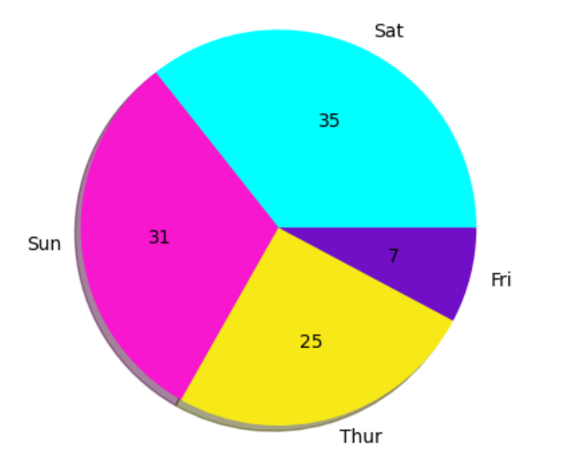
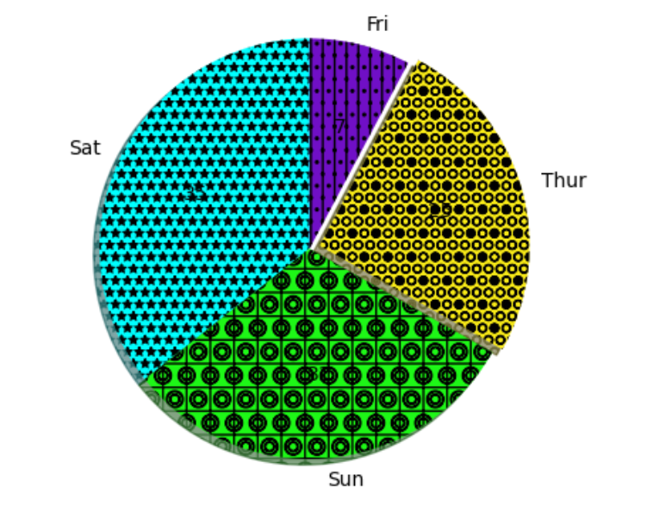
Pie plot

Slide 92
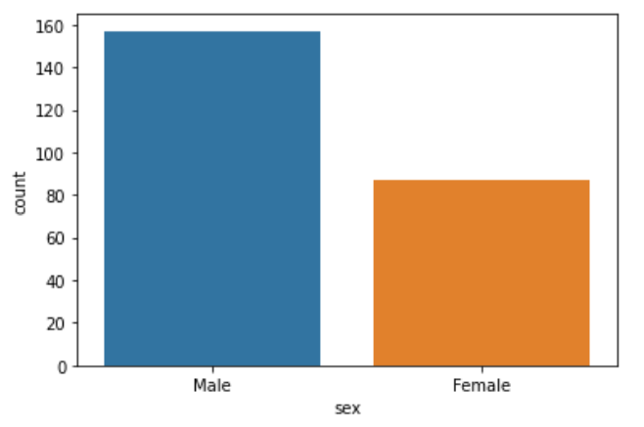

Count plot

Slide 93


Box & bar plot

Slide 94


Violin & strip plot

Slide 95


Distribution plot

Slide 96


heatmap

Slide 97
Thank you

